Slide 1
Session 3: Page Object Model
Author: Anh Pham
TMA Solutions
www.tmasolutions.com

Slide 2
Agenda
What is the problem?
What is Page Object Model (POM)?
How to implement?
Practices
Refer document

Slide 3
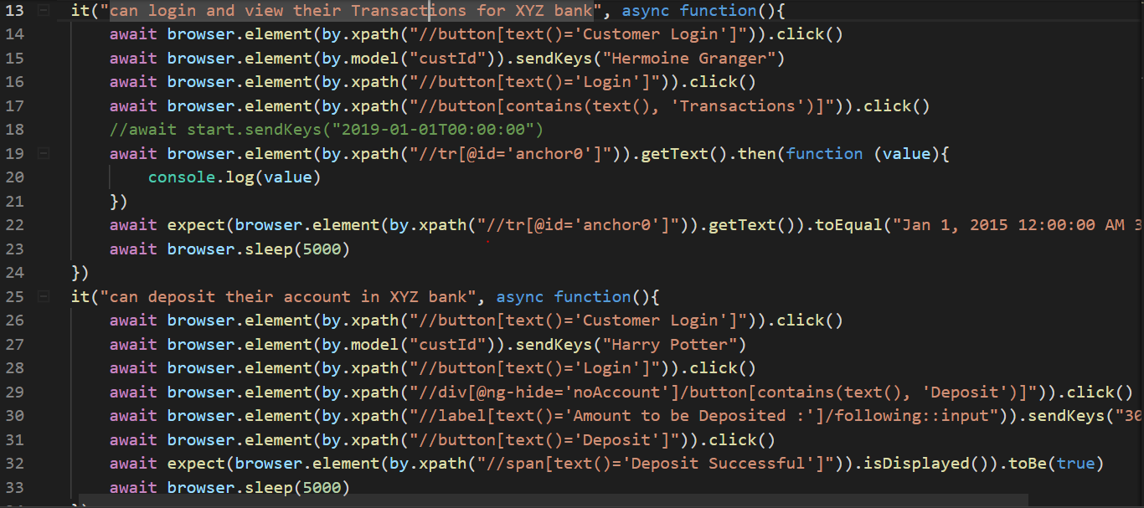
What is the problem?
1. Duplicated code
2. Hard to maintain
3. Hard to understand

Slide 4
What is Page Object Model (POM)?
POM a design pattern to create Object Repository for web UI elements. Here, all element locators used by the application will be stored in separated class from testcases.
Page Object Model
Page Object Class
Locators and testscripts stored separately
Element locators
Methods performing operations on elements
PageObject Class
Testcases
Testcases
Actual test scenario
Calls to methods in page object class with arguments

Slide 5
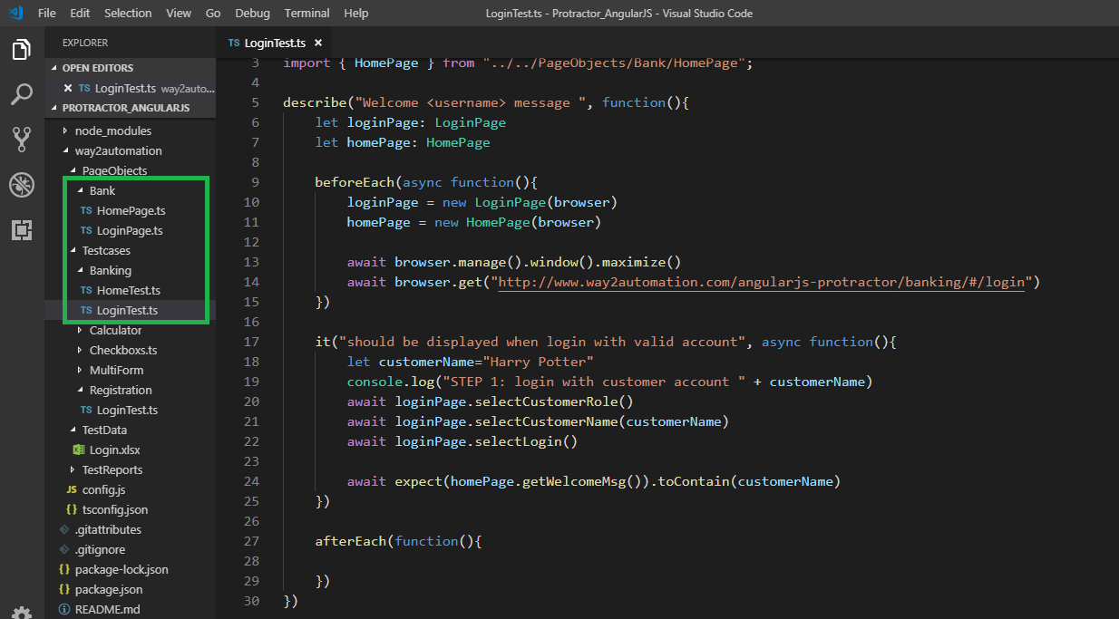
Demo how to implement

Slide 6
Practices
Apply Page Object Models for
http://www.way2automation.com/angularjs-protractor/banking/#/login
http://travelwithus.asia/
https://www.lego.com/en-us

Slide 7
Documents
POM
https://www.guru99.com/page-object-model-pom-page-factory-in-selenium-ultimate-guide.html#1
https://medium.com/tech-tajawal/page-object-model-pom-design-pattern-f9588630800b

Slide 8
THANK YOU!
Vietnam:
North America:
+84 28 3997 8000
+1 844 224 4188
Australia:
Japan:
+61 414 734 277
+81 364 324 994
Email:
sales@tmasolutions.com
www.tmasolutions.com
Website:

